Slide 1
TNSDC NAAN MUDHALAVAN PROJECT
STUDENT NAME: A.Kushboo
REGISTER NO AND NMID: 22241096
DEPARTMENT: BSC ( Computer Science )
COLLEGE: COLLEGE/: Sri Balaji Arts and Science College
UNIVERSITY : University of Madras

Slide 2
PROJECT TITLE
DESIGN AND
DEVELOPMENT OF A
PERSONAL PORTFOLIO
WEBSITE ..🎗️🪩! !
>>>👧🎓🌍! !

Slide 3


AGENDA
Problem Statement
Project Overview
End Users
Tools and Technologies
Portfolio design and Layout
Features and Functionality
Results and Screenshots
Conclusion
Github Link
3/21/2024 Annual Review

Slide 4

Problem Statement
Traditional resumes and offline portfolios fail to showcase creativity and interactivity.
Lack of a centralized digital platform to present personal skills, projects, and achievements.
Difficulties for recruiters, employers, or clients to evaluate an individual’s capabilities effectively.
Limited accessibility and visibility of offline or static profiles in the digital world.
Need for a personal portfolio website that is interactive, visually appealing, and easy to update.

Slide 5

Project Overview
The project aims to design and develop a personal portfolio website that highlights an individual’s skills, achievements, and projects in a professional manner.
It provides a centralized digital platform to present personal and professional information.
The website will be interactive, user-friendly, and visually appealing, ensuring a strong first impression.
It will include sections like About Me, Skills, Projects, Resume, and Contact Information.
The portfolio website will act as a digital identity, improving visibility and accessibility for recruiters, employers, and collaborators.
This project focuses on designing and developing a personal portfolio website that highlights academic achievements, technical skills, projects, certifications, and contact details. The portfolio will be responsive, user-friendly, and visually engaging.

Slide 6

Who are the end users?
Students – to showcase academic achievements, projects, and skills.
Job Seekers / Freshers – to present resumes, skills, and portfolios to employers.
Freelancers – to display their work, services, and client projects.
Professionals – to highlight career achievements and personal branding.
Employers / Recruiters / Clients – to easily evaluate candidate profiles and work samples.

Slide 7

Tools and technologies
HTML5 & CSS3 – for webpage structure and styling.
JavaScript – to add interactivity and dynamic features.
Bootstrap / Tailwind CSS – for responsive and modern design.
VS Code & GitHub – for development and version control.
Netlify / Vercel – for hosting and deployment.

Slide 8
Portfolio design and layout
Home Page – Brief introduction with name, tagline, and navigation menu.
About Section – Personal details, education, and professional background.
Skills Section – Technical and soft skills displayed with visuals or progress bars.
Projects Section – Showcase of work samples, case studies, and achievements.
Contact Section – Contact form, email, and social media links.
8

Slide 9
Features of Functionality
Responsive Navigation – Smooth movement across all sections and devices.
Interactive Project Showcase – Users can view projects with images, links, and details.
Contact Form Integration – Allows visitors to send direct messages or queries.
Resume Download Option – Easy access to CV in PDF format.
Social Media & Email Connectivity – Direct links for networking and communication.

Slide 10
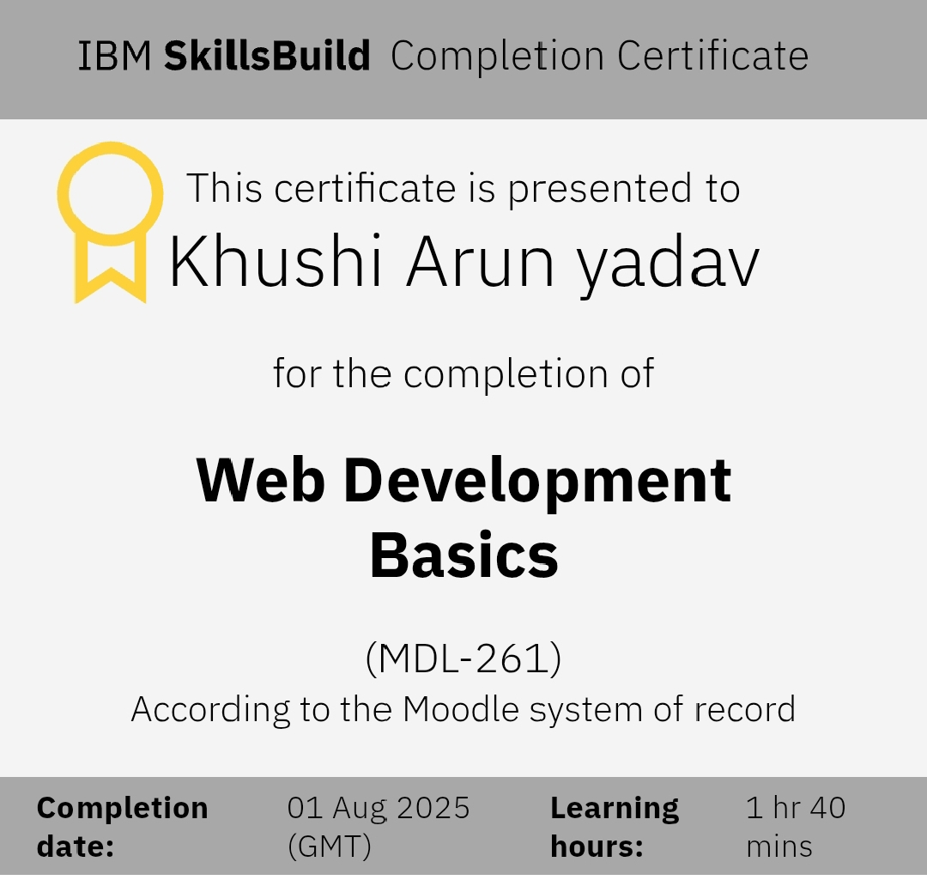
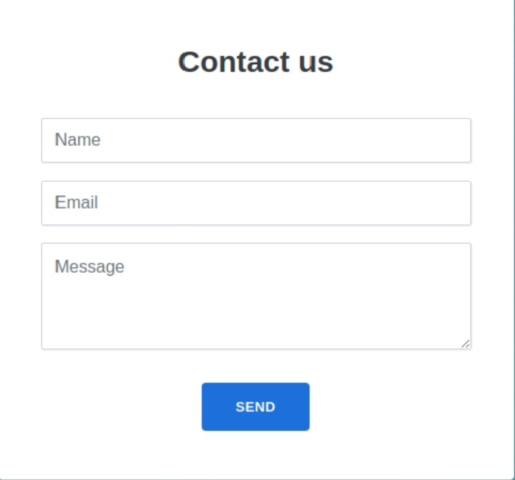
Results📩
Screenshot🎓💯
10

Slide 11
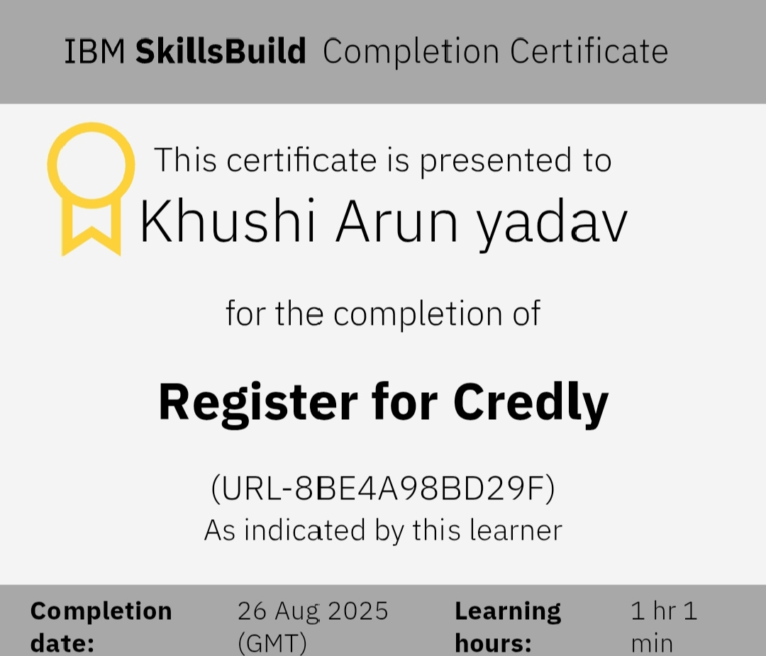
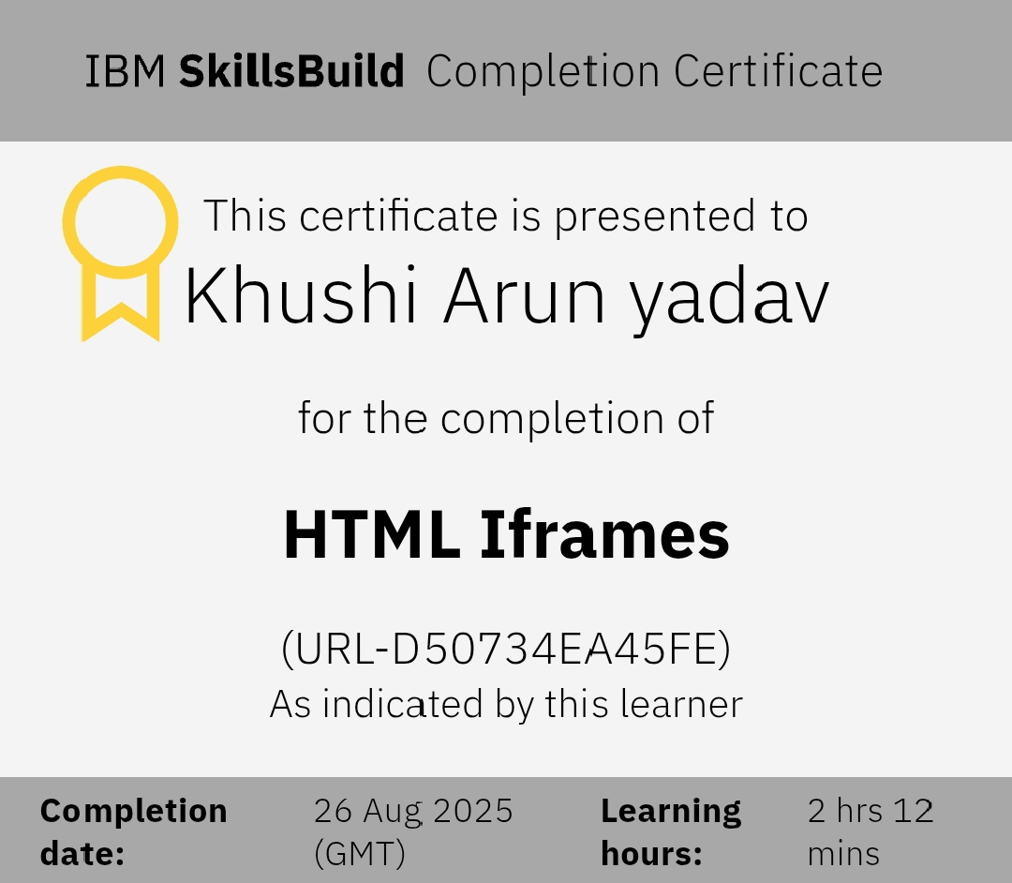
Results📩
Screenshot🎓💯

Slide 12
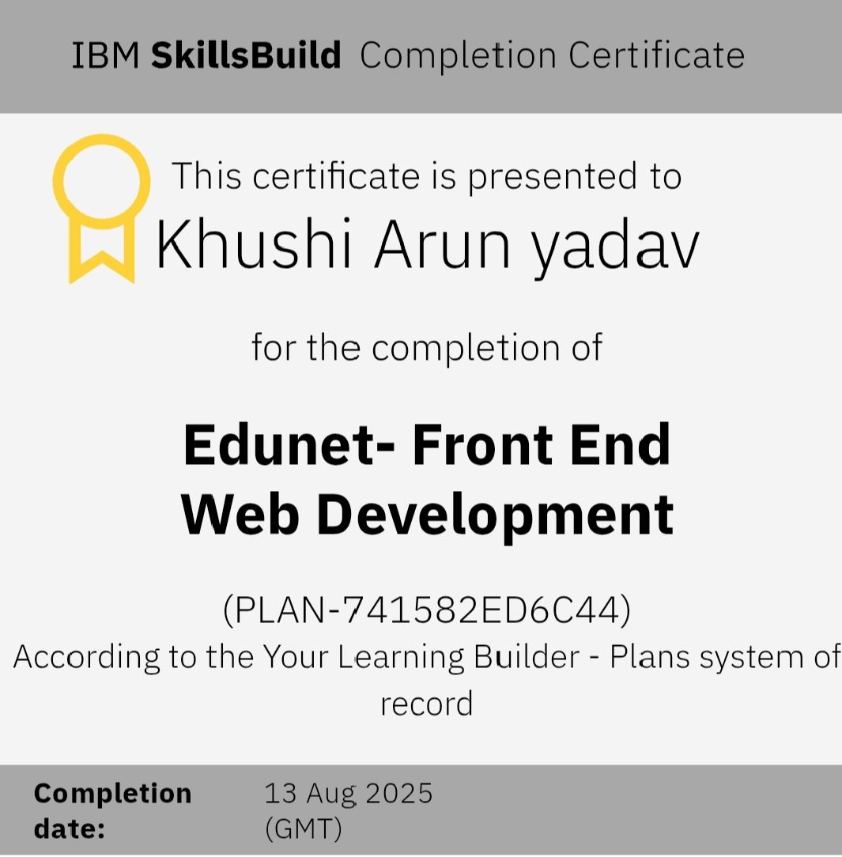
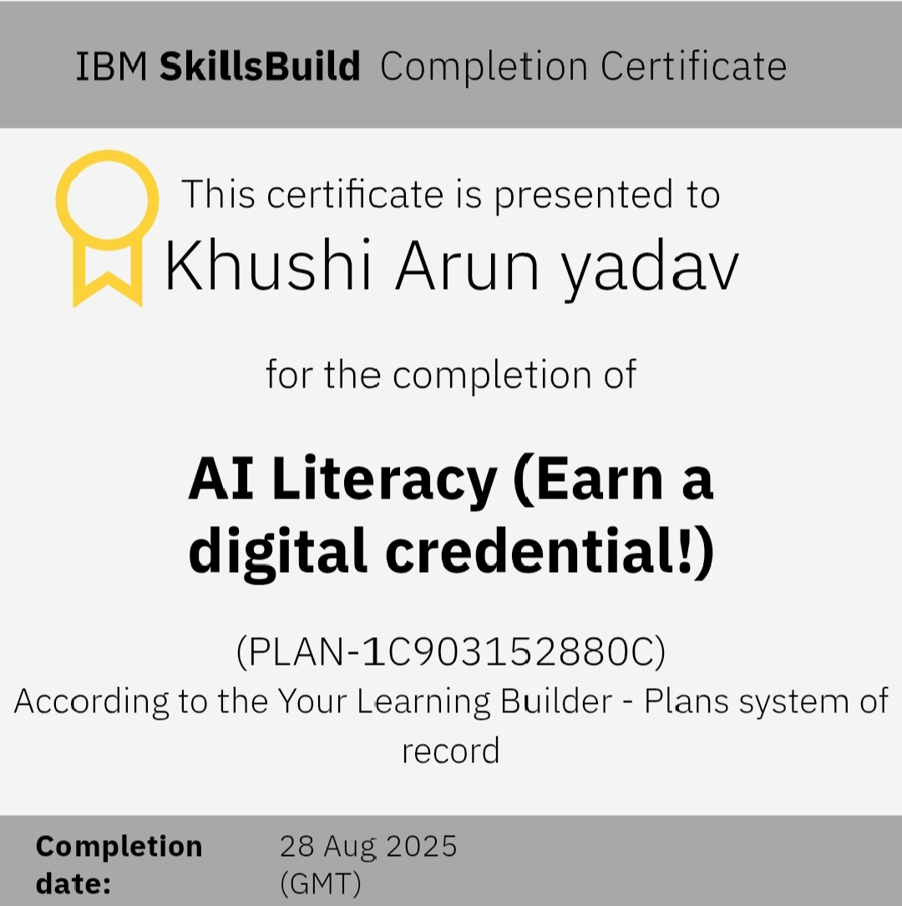
Results📩
Screenshot🎓💯

Slide 13
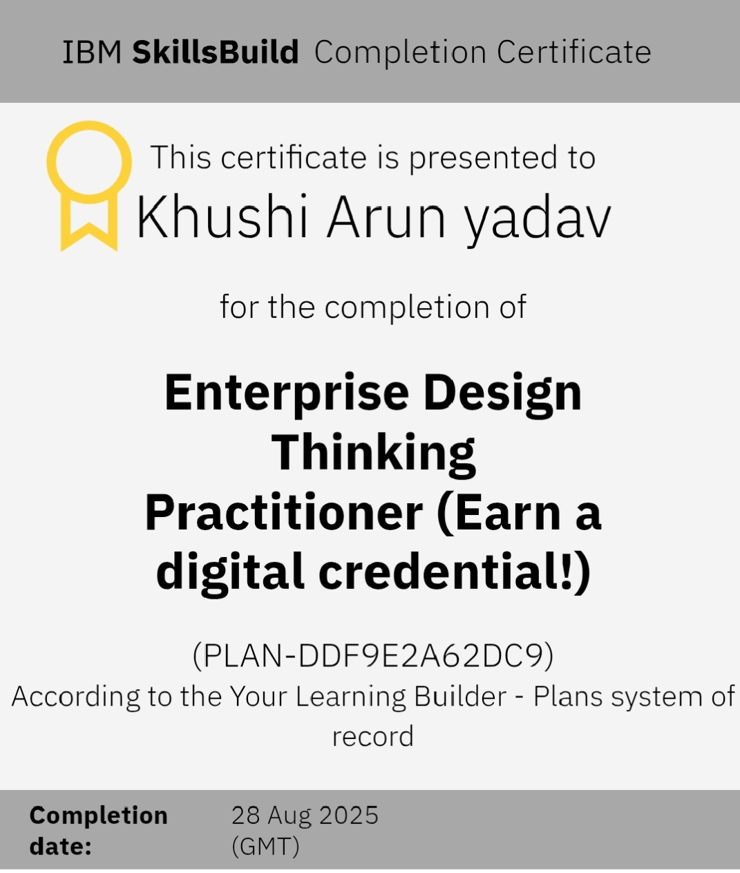
Results📩
Screenshot🎓💯

Slide 14
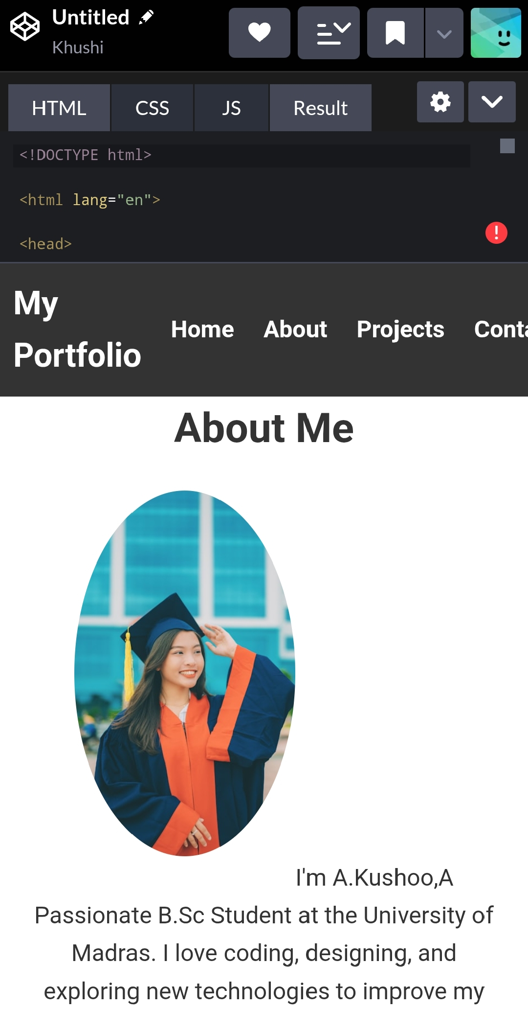
Results📩
Screenshot🎓💯

Slide 15
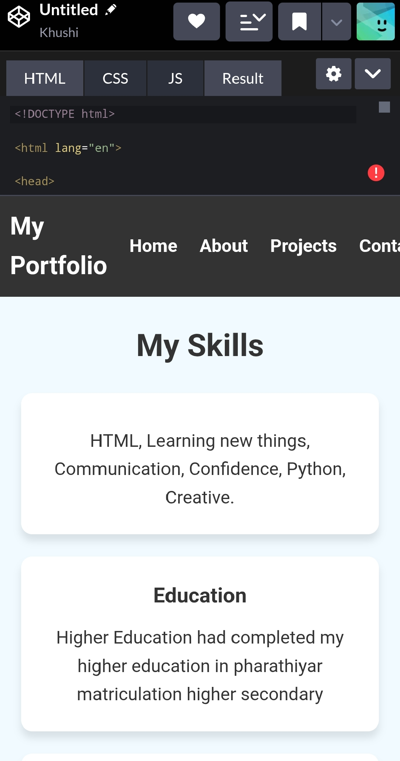
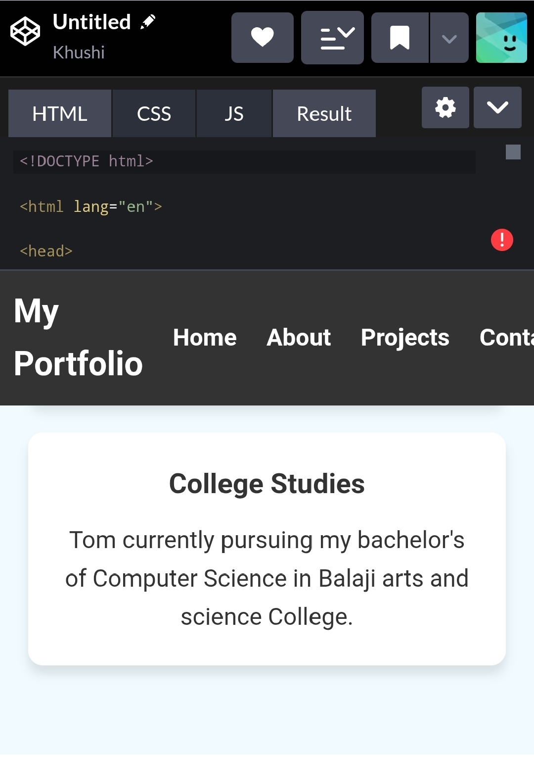
Results📩
Screenshot🎓💯

Slide 16
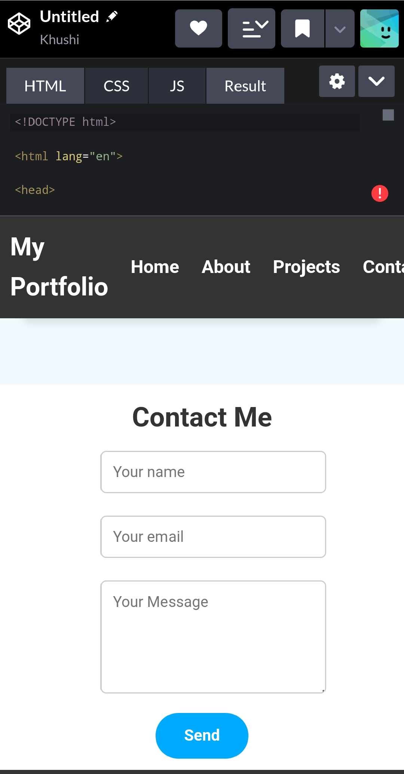
Results📩
Screenshot🎓💯

Slide 17
Conclusion
User-Centered Design – Simple, clean, and attractive layout focusing on usability.
Responsive Development – Ensures compatibility across mobile, tablet, and desktop devices.
Showcasing Skills & Projects – Well-structured sections for personal details, skills, and project highlights.
Interactive Features – Navigation bar, animations, contact form, and resume download.
Hosting & Deployment – Publishing the website online using platforms like GitHub Pages, Netlify, or custom domains.
17

